Slide 1
Guide to Project Reporting & Documentation Tools

Slide 2
Using MS Word for Project Documentation
Session Overview & Sub‑Topics
Basics of Draw.io for Diagrams & Flowcharts
How to Choose & Scope Your Project Topic

Slide 3
MS Word for Project Reports
Techniques to Format and Organize Your Documentation

Slide 4
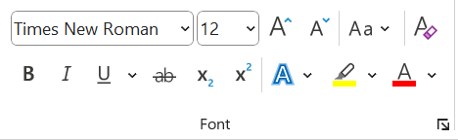
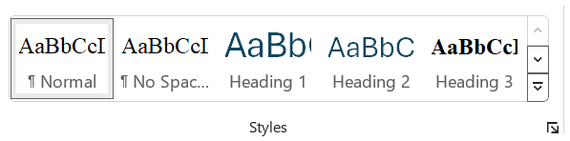
Ensures uniform font, size, and formatting throughout the document.
Using Styles and Headings
Avoids manual formatting errors
Quickly apply or change formatting across the entire document by updating a style.

Slide 5
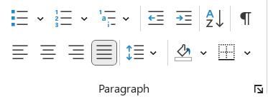
Use bullets for items that don’t need a specific order (e.g., features, ideas, benefits).
Using Bullet Point and Numbering
Use numbering when the order matters (e.g., instructions, processes, priorities).

Slide 6
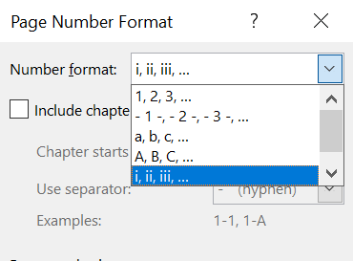
Pages before Chapter 1 (from student’s declaration to the page before Chapter 1) use Roman numerals (ii, iii, iv, etc.).
Adding Page Numbers
Page Numbering starts from ii because the first page (usually the cover or title page) is counted as i but left unnumbered or hidden.
Pages from Chapter 1 onwards use regular Arabic numbers starting from 1.
All page numbers should be placed at the bottom center of the page.

Slide 7
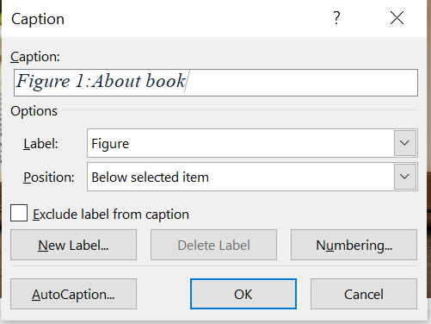
Figure captions should be centered below the figures.
Adding Figures and Tables Captions
Table captions should be centered above the tables.
All captions must be written in Times New Roman, font size 12, bold, and center-aligned.

Slide 8
Apply heading styles to your document titles, then go to the References tab and insert an automatic table of contents.
How to Insert & Update a Table of Contents Automatically
After making changes, click inside the table of contents and select Update Table to refresh the headings and page numbers.

Slide 9
Creating Diagrams & Flowcharts with Draw.io
A Simple Guide to Visualizing Your Ideas and Processes

Slide 10
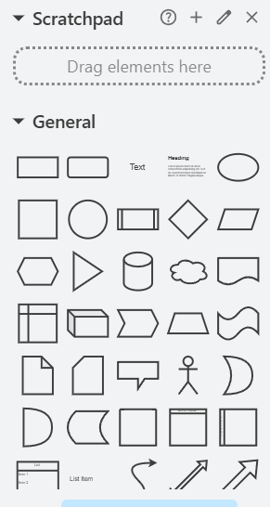
Easy drag-and-drop interface
Features of Draw.io
Wide range of shapes & templates
Integration with cloud storage
Collaboration features

Slide 11
How to Choose and Scope Your Project Topic
Selecting the Right Idea and Defining Clear Boundaries for Your Project

Slide 12
Identify a Specific Company
How to Choose a Project Topic
Look for specific operational issues the company faces, such as order delays, stock shortages, or manual billing.

Slide 13
Common Mistakes During the Summer Project
No actual need identified
Disconnected documentation
Vague or missing objectives
No focus on outcomes

Slide 14
What Your Project and Documentation Should Clearly Include
Problem Faced by the Company
Your Project Objectives
How Your Project Solves It

Slide 15
Extra Tools That Make Your Projects Easier
Git & GitHub
Docker

Slide 16
Any Question ?

